Slide 1
Subcommittee on Minnesota Water Policy
February 17, 2020
Co-Chairs: Rep. Peter Fischer
Sen. Bill Weber
Jim Stark, Director

Slide 2
Agenda
Call to Order
Approval of Minutes, January 17, 2020
Director’s Report – Subcommittee Priorities: Jim Stark
Groundwater Quality, Nitrate Assessment: Craig Cox and Jamie Konopacky, Environmental Working Group
Discussion - Wadena County petition – State water appropriation and environmental review process: Jim Stark
Private Wells and Drinking Water Safety: Chris Elvrum, MDH, and staff
Adjourn

Slide 3
Presentation
Director’s Report: Subcommittee Legislative Priorities ~ Jim Stark

Slide 4
Director’s Report: Proposed Legislative Water Policy Topics for 2020
Legislative topics – based on member suggestions, input from constituents, agencies, and stakeholders
Topics have been reviewed and refined
They represent most important needs
Described during past meetings
Bills have been prepared
Next steps: Introductions and hearings or informational meetings

Slide 5
Process
Three Categories:
Bills similar to those introduced in 2019
Bills that address new topics
Issues that need further discussion and planning
They are listed and described in the handout
Bills have been drafted

Slide 6
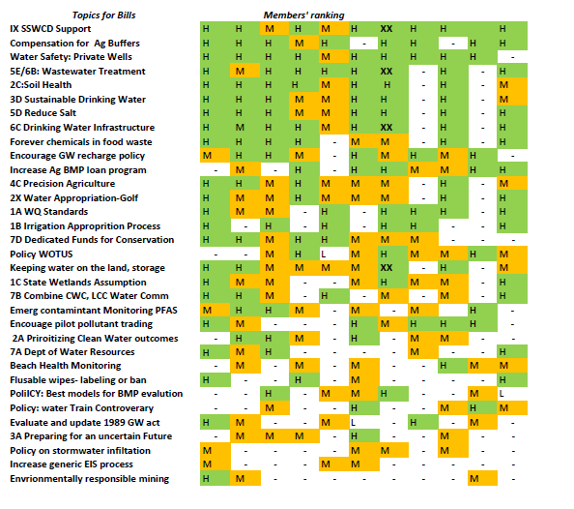
Issues: Topical Support

Slide 7
Process (part 2)
Next Steps:
Indicate bills you can introduce or co-author
Based on that, bills will be provided for your review and revision
Bills will be jacketed

Slide 8
Presentation 2:
Nitrate Contamination in Minnesota Wells, Trends in Community Water Systems : Craig Cox and Jamie Konopacky, and staff ~ Environmental Working Group

Slide 9
Presentation 3:
Private Well Protection in Minnesota, Chris Elvrum, MDH

Slide 10
Discussion:
Water Appropriation Permits – Wadena County Resolution

Slide 11
Announcements:
Updates
Next meeting: ?
Thanks!

